Slide 1
Research on irregular migration out of Africa to Europe
Huijun Cui
10.29.2018

Slide 2
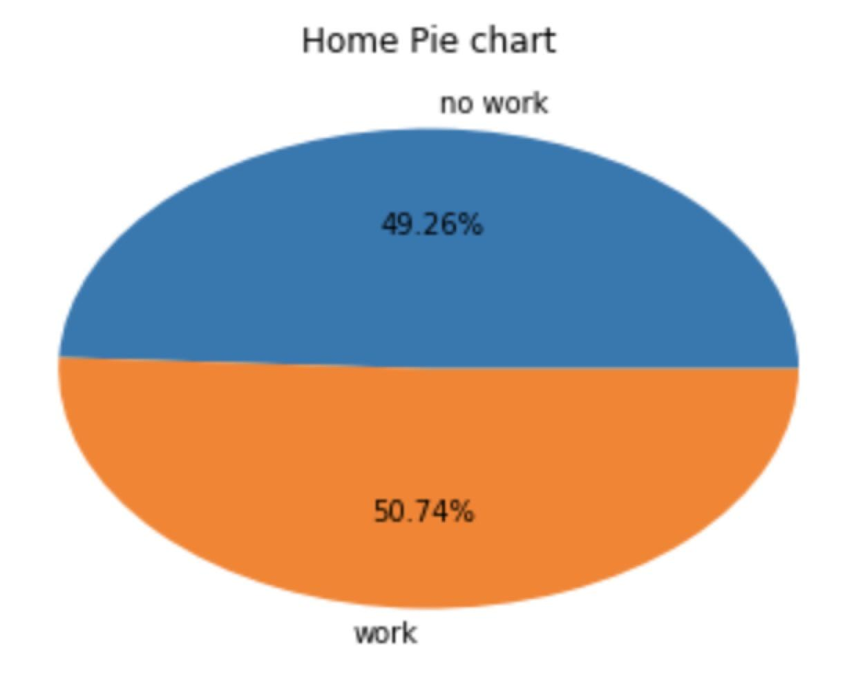
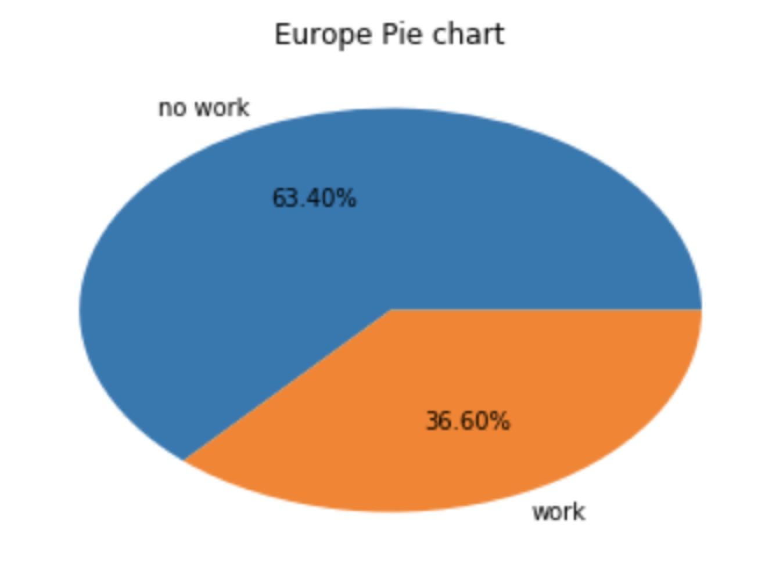
Work percentage comparison

Slide 3
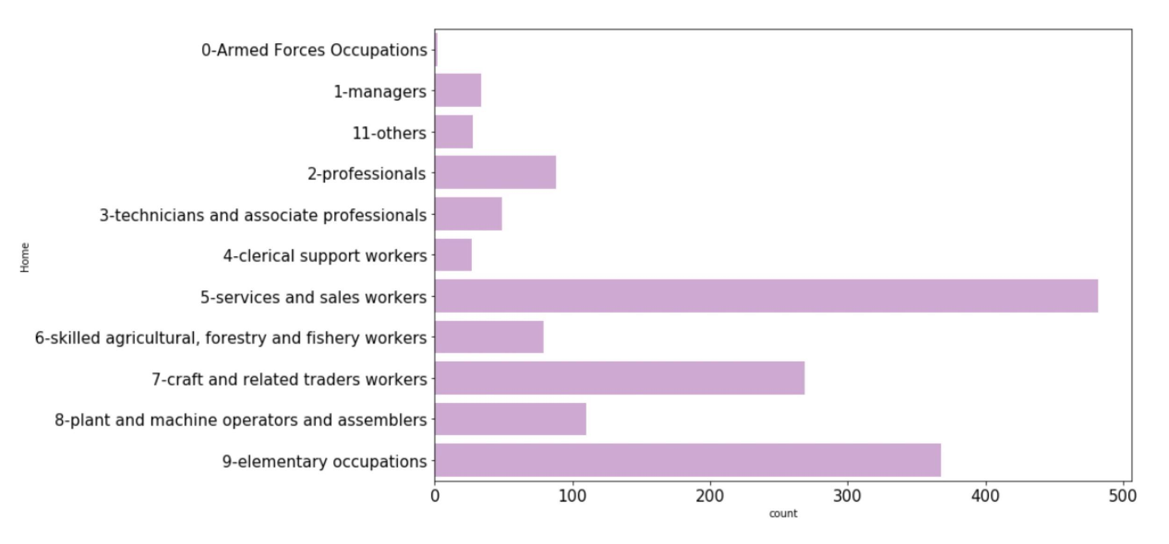
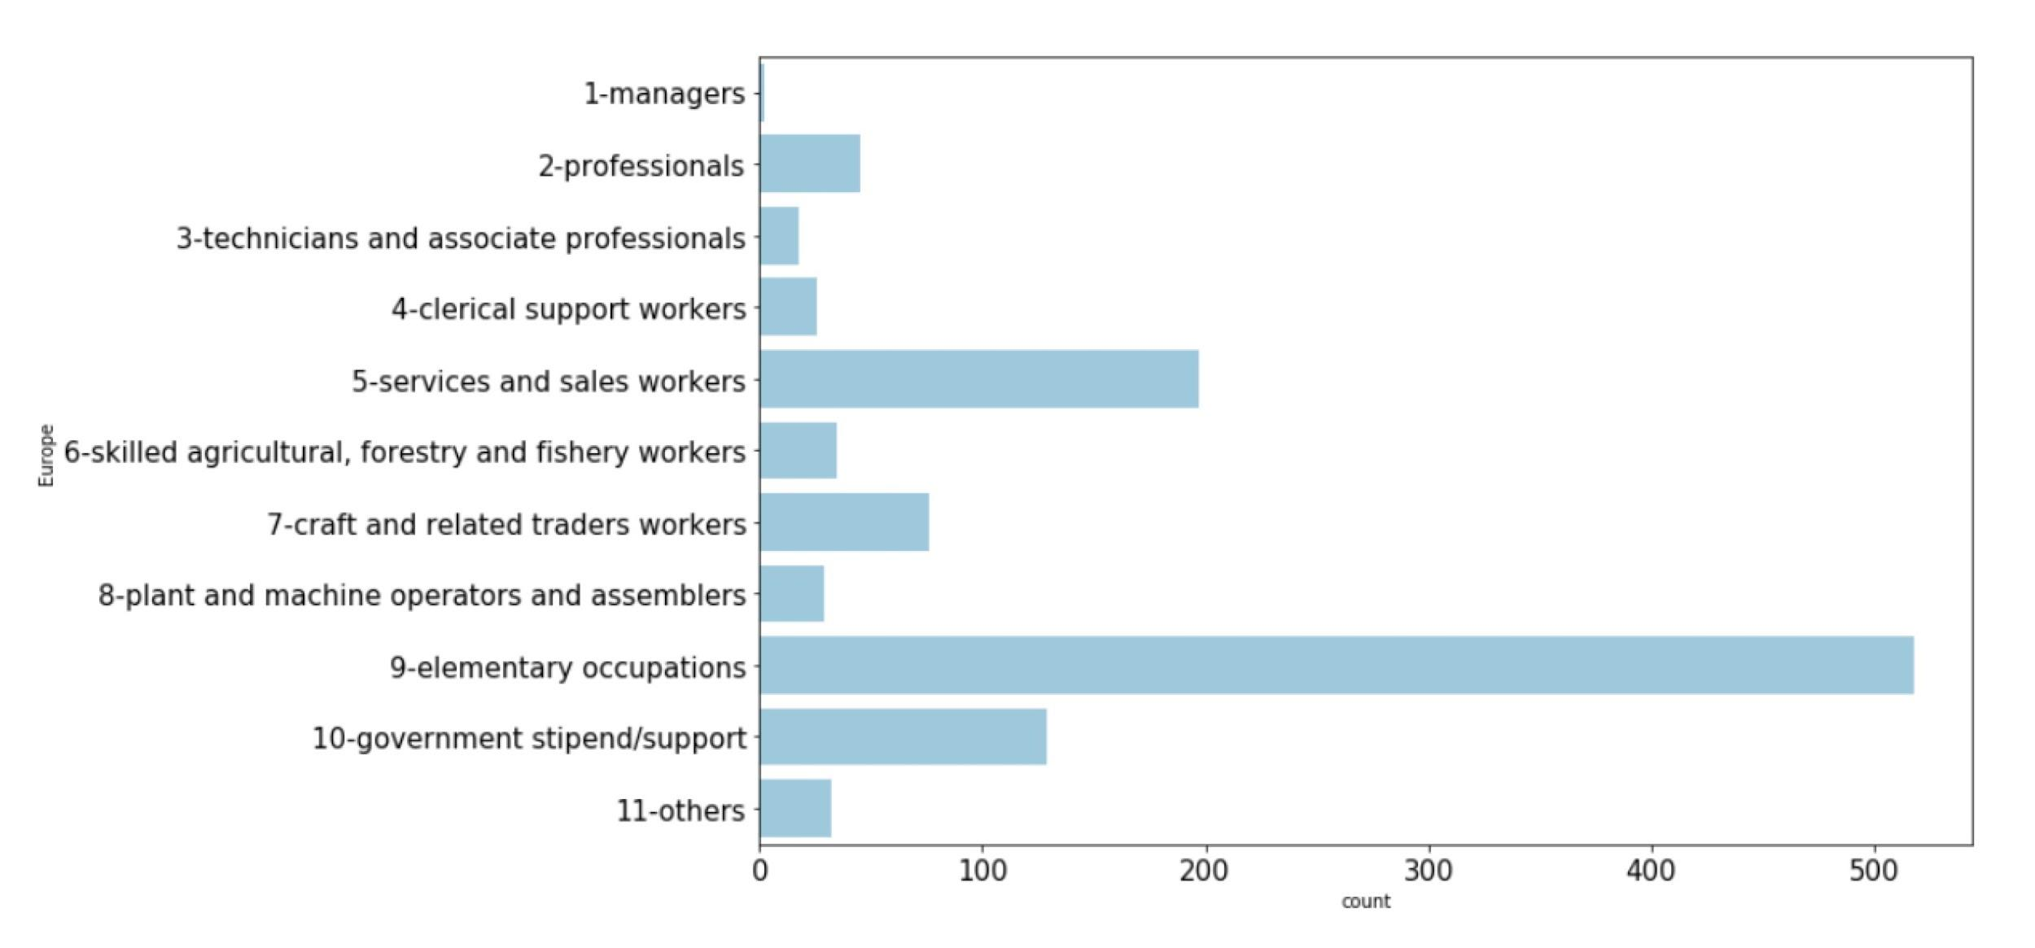
Career type distribution in homeland
Career type distribution in Europe

Slide 4
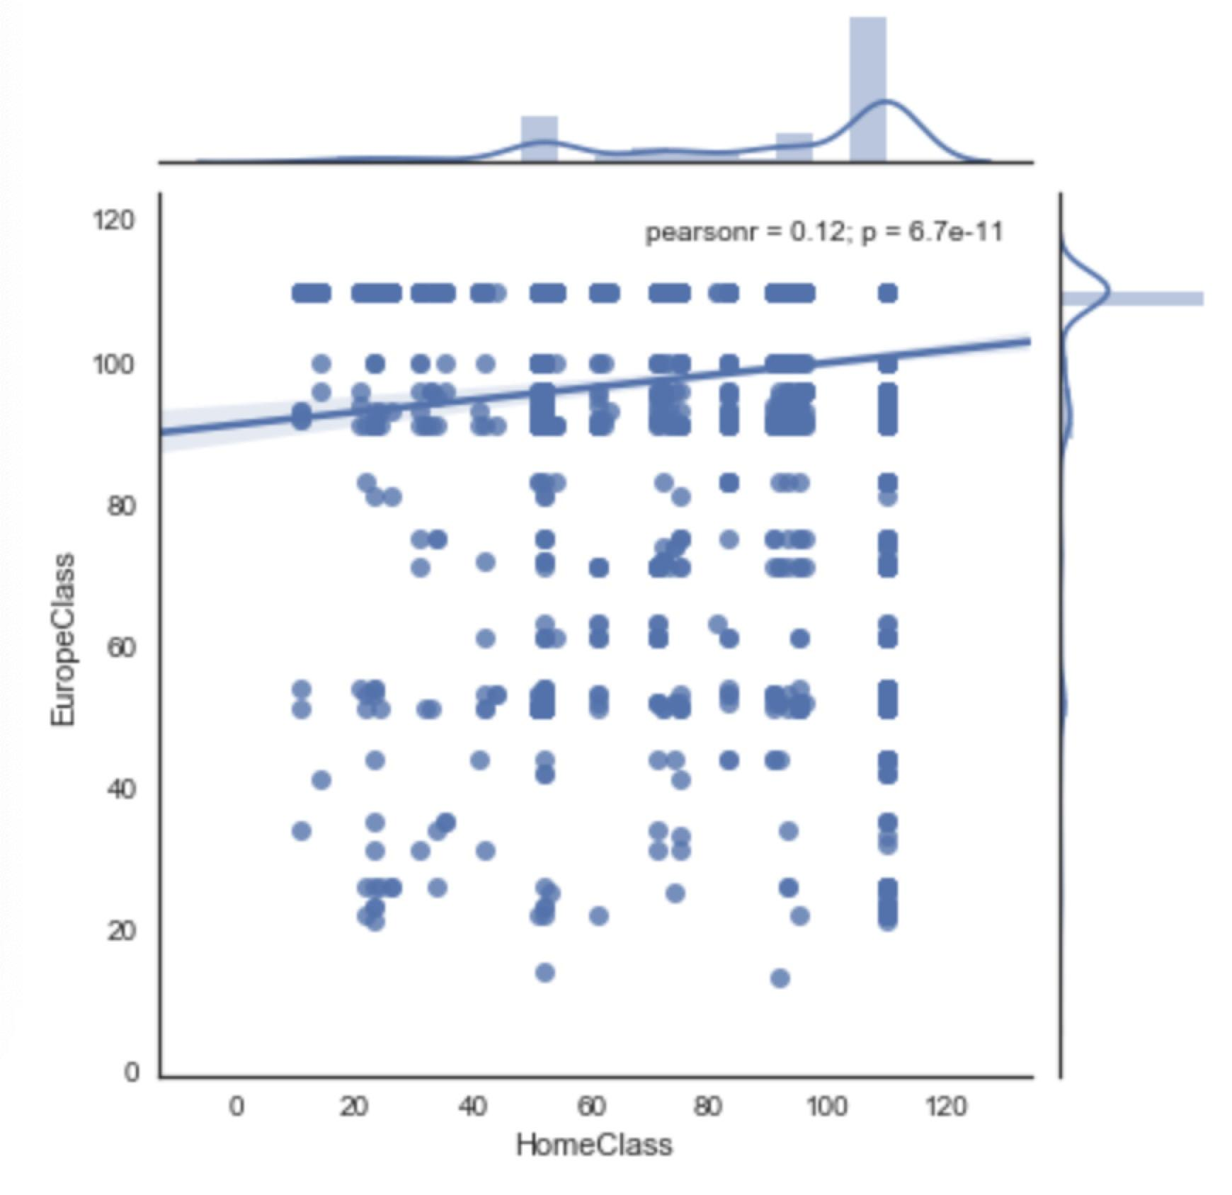
Scatter plot
The correlation relationship between the profession classes in home countries and europe countries. The bigger number means the lower social classes.

Slide 5
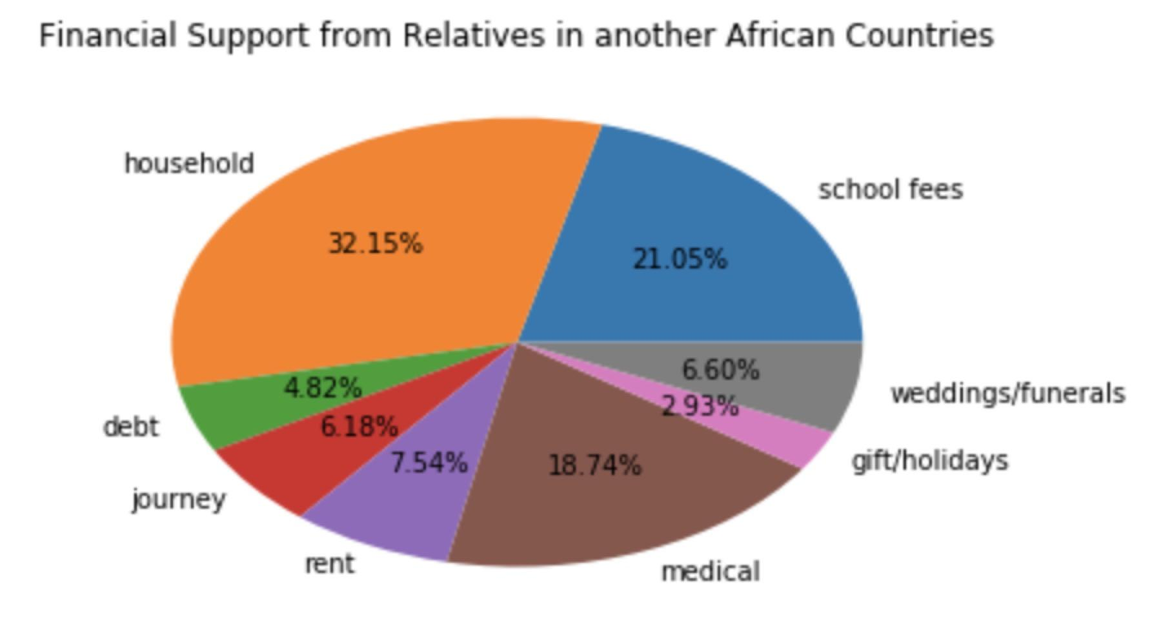
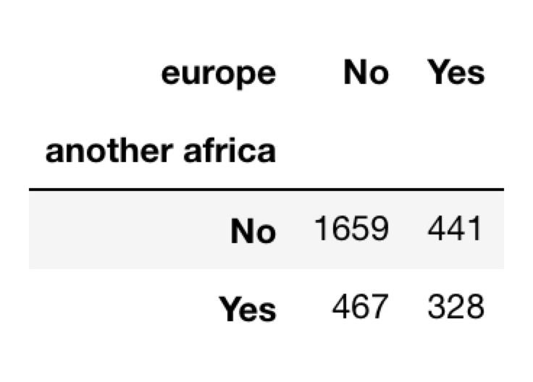
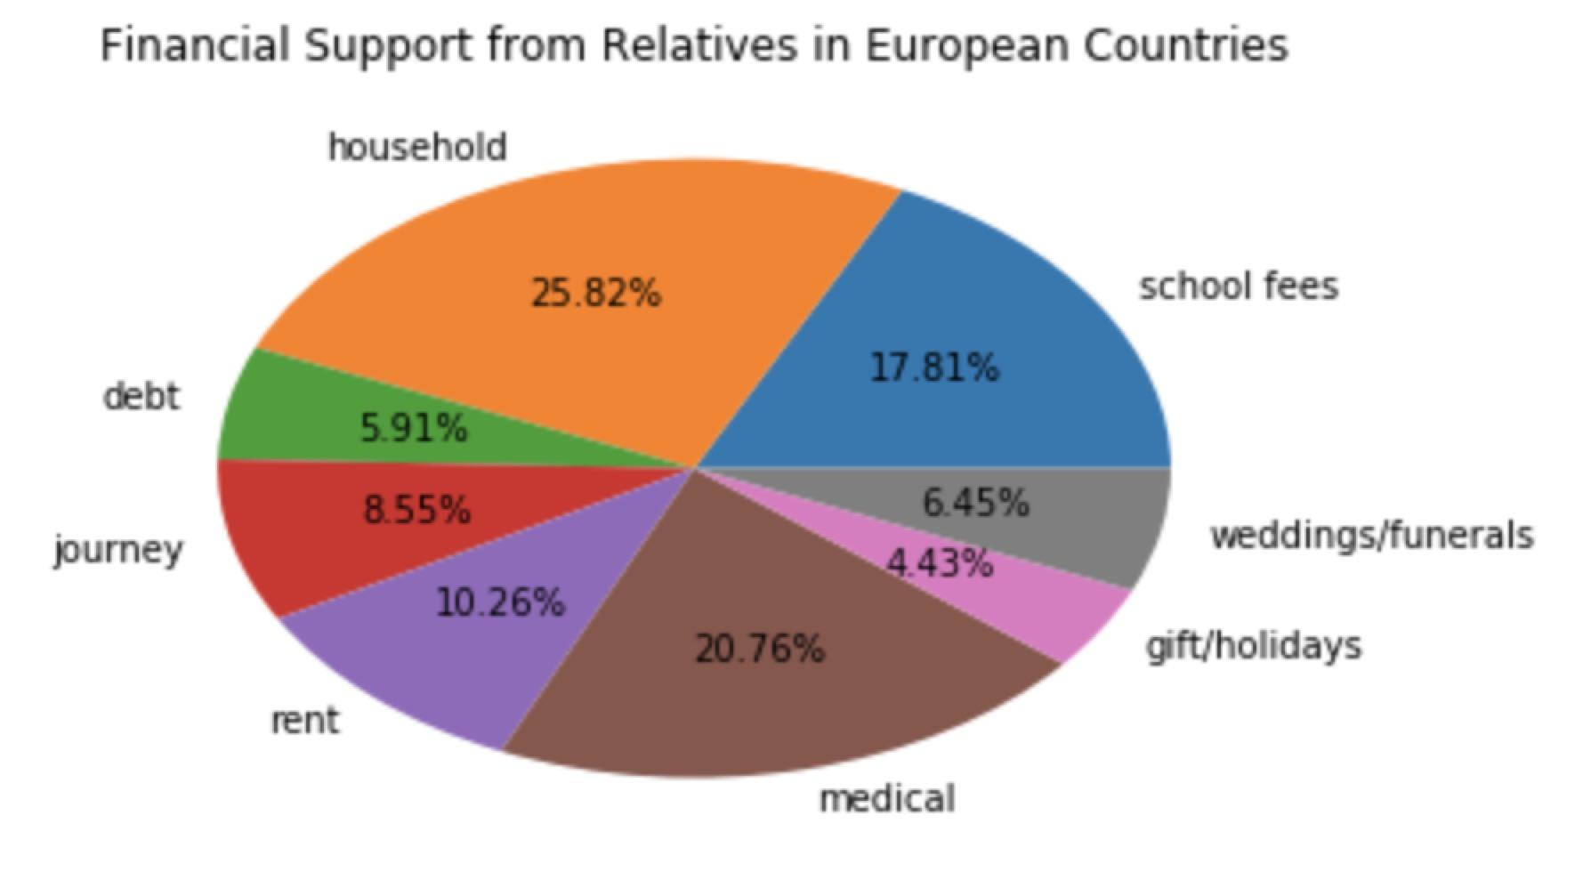
Percentage of financial support from relatives abroad

Slide 6
Thank You!

